Slide 1
I’m thinking of a number …
1
2
3
4
5
6
7
8
9
10
11
12
13
14
15
16
17
18
19
20
21
22
23
24
25
26
27
28
29
30
31
32
33
34
35
36
37
38
39
40
41
42
43
44
45
46
47
48
49
50
51
52
53
54
55
56
57
58
59
60
61
62
63
64
65
66
67
68
69
70
71
72
73
74
75
76
77
78
79
80
81
82
83
84
85
86
87
88
89
90
91
92
93
94
95
96
97
98
99
100

Slide 2
1
2
3
4
5
6
7
8
9
10
Is it greater than 50?
11
12
13
14
15
16
17
18
19
20
Yes
21
22
23
24
25
26
27
28
29
30
31
32
33
34
35
36
37
38
39
40
41
42
43
44
45
46
47
48
49
50
51
52
53
54
55
56
57
58
59
60
61
62
63
64
65
66
67
68
69
70
71
72
73
74
75
76
77
78
79
80
81
82
83
84
85
86
87
88
89
90
91
92
93
94
95
96
97
98
99
100

Slide 3
1
2
3
4
5
6
7
8
9
10
Is it even?
11
12
13
14
15
16
17
18
19
20
No
21
22
23
24
25
26
27
28
29
30
31
32
33
34
35
36
37
38
39
40
41
42
43
44
45
46
47
48
49
50
51
52
53
54
55
56
57
58
59
60
61
62
63
64
65
66
67
68
69
70
71
72
73
74
75
76
77
78
79
80
81
82
83
84
85
86
87
88
89
90
91
92
93
94
95
96
97
98
99
100

Slide 4
1
2
3
4
5
6
7
8
9
10
Is the 1s digit greater than 5?
11
12
13
14
15
16
17
18
19
20
21
22
23
24
25
26
27
28
29
30
No
31
32
33
34
35
36
37
38
39
40
41
42
43
44
45
46
47
48
49
50
51
52
53
54
55
56
57
58
59
60
61
62
63
64
65
66
67
68
69
70
71
72
73
74
75
76
77
78
79
80
81
82
83
84
85
86
87
88
89
90
91
92
93
94
95
96
97
98
99
100

Slide 5
1
2
3
4
5
6
7
8
9
10
Is it in an odd 10s row?
11
12
13
14
15
16
17
18
19
20
Yes
21
22
23
24
25
26
27
28
29
30
31
32
33
34
35
36
37
38
39
40
41
42
43
44
45
46
47
48
49
50
51
52
53
54
55
56
57
58
59
60
61
62
63
64
65
66
67
68
69
70
71
72
73
74
75
76
77
78
79
80
81
82
83
84
85
86
87
88
89
90
91
92
93
94
95
96
97
98
99
100

Slide 6
1
2
3
4
5
6
7
8
9
10
If we join each two neighbouring rows and each two neighbouring columns together, are the column and row odd-odd or even-even?
I’m sorry I drew the animation before realising it’s a pain to write down in words but hopefully you get the idea
11
12
13
14
15
16
17
18
19
20
21
22
23
24
25
26
27
28
29
30
31
32
33
34
35
36
37
38
39
40
41
42
43
44
45
46
47
48
49
50
51
52
53
54
55
56
57
58
59
60
61
62
63
64
65
66
67
68
69
70
71
72
73
74
75
76
77
78
79
80
Yes
81
82
83
84
85
86
87
88
89
90
91
92
93
94
95
96
97
98
99
100

Slide 7
1
2
3
4
5
6
7
8
9
10
Is the combined double 10s rows even?
11
12
13
14
15
16
17
18
19
20
21
22
23
24
25
26
27
28
29
30
Yes
31
32
33
34
35
36
37
38
39
40
41
42
43
44
45
46
47
48
49
50
51
52
53
54
55
56
57
58
59
60
61
62
63
64
65
66
67
68
69
70
71
72
73
74
75
76
77
78
79
80
81
82
83
84
85
86
87
88
89
90
91
92
93
94
95
96
97
98
99
100

Slide 8
Is it greater than 50?
1
2
3
4
5
6
7
8
9
10
If we join each two neighbouring rows and each two neighbouring columns together, are the column and row odd-odd or even-even?
11
12
13
14
15
16
17
18
19
20
Is it even?
21
22
23
24
25
26
27
28
29
30
Is the 1s digit greater than 5?
31
32
33
34
35
36
37
38
39
40
41
42
43
44
45
46
47
48
49
50
51
52
53
54
55
56
57
58
59
60
Is it in an odd 10s row?
61
62
63
64
65
66
67
68
69
70
71
72
73
74
75
76
77
78
79
80
Is the combined double 10s rows even?
81
82
83
84
85
86
87
88
89
90
91
92
93
94
95
96
97
98
99
100

Slide 9
You should know about: compressive sensing
Alex Tritt
Melbourne MLAI Meetup; Tuesday, 2023-10-17; 912 Collins St, Docklands, Victoria, Australia

Slide 10


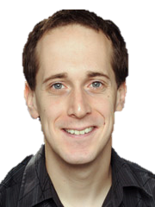
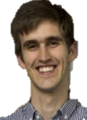
Who am I?
Alex Tritt
Experimental physics PhD student at Monash University
Working in quantum sensing (quantum tech)
Supervised by experimental physicist Lincoln Turner and applied mathematician James Saunderson
Know machine learning “proper” from a course in undergrad 4 years ago

Slide 11
data must come from somewhere
Much of ML and data science is about what to do with data after you get it.
Here we look at issues in taking the data in the first place.
How many measurements do we need to take?
Nyquist-Shannon sampling theorem:
A continuous signal that has a finite duration and frequency bandwidth can be represented with a finite number of samples
A 12 megapixel camera is still 36 million separate measurements!

Slide 12
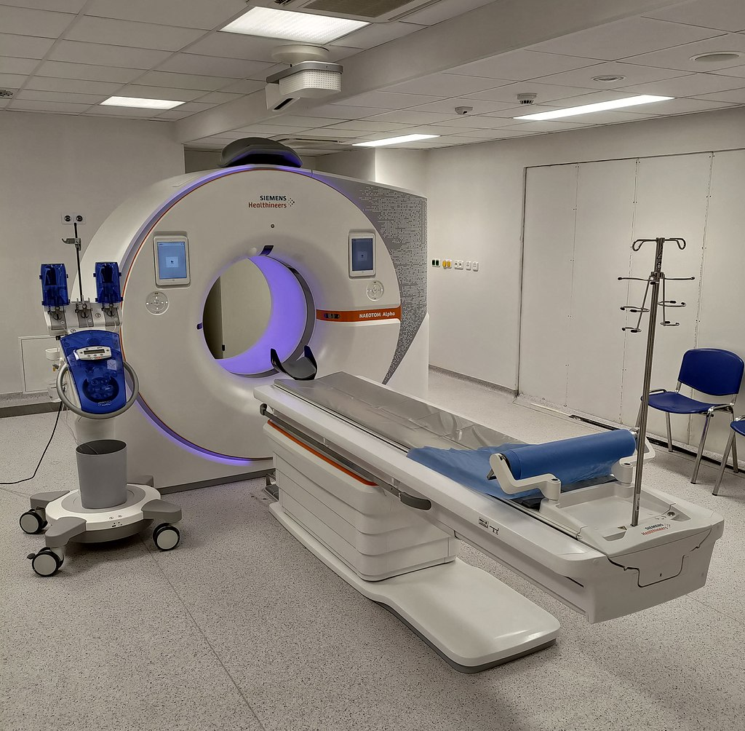
Data taking can be “expensive”
Some “colours” of infra-red and ultra-violet are difficult to make detectors for
CT scans expose patients to cancer-causing x-rays
MRI scans are uncomfortable for patients
For me: quantum materials are super fragile

Slide 13

Compression and sparsity
Pretty much all useful signals are sparse in some sense.
Pictures of objects are assumed to be of solid blocks of colour…
… which means they are sparse in spatial frequency.
JPEG stores a small number of spatial frequency components…
… but you still have to measure all of them.
DCT spatial
frequencies (almost JPEG)
Original

Slide 14
The Heisenberg uncertainty principle?
Signals with condensed energy in one domain have spread-out energy under a frequency transform (like FFT or DCT)
Sparse signals in general have spread out energy if the frequency transform “behaves nicely”
delta “function” (is pretty sparse)
time
t₀
Fourier transform
1/t₀
frequency

Slide 15
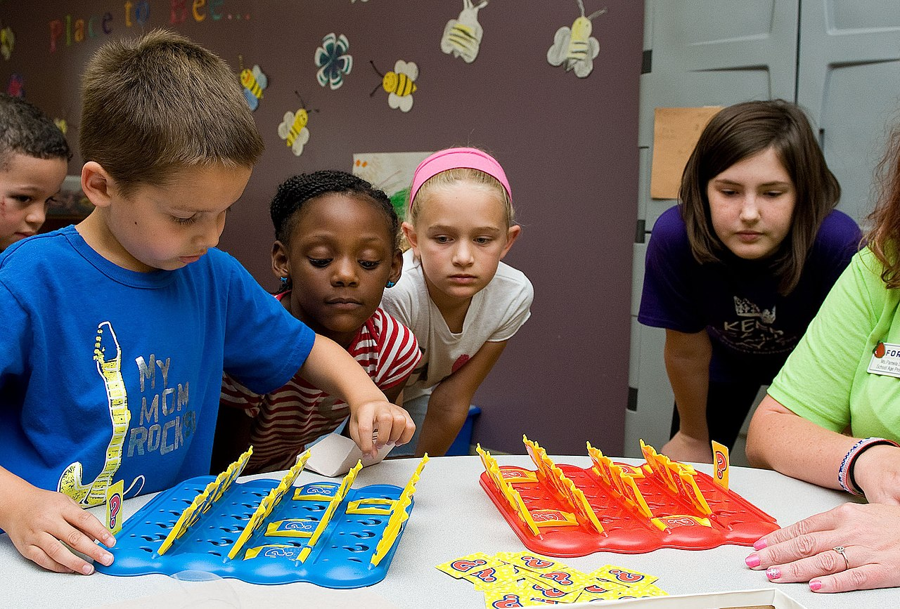
Incomplete frequency transforms
Just like with “guess a number”, taking a frequency transform gets sweeping information about the whole sparse signal.
And, also like with “guess a number”, one can capture the full signal with way fewer measurements that usual.
Compressive sensing (compressed sensing, compressive sampling).
The measurement itself is the compressed form.

Slide 16
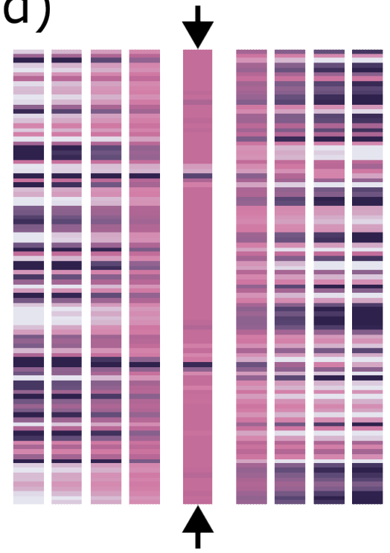


Recovery?
Underdetermined linear system means many signals could produce the samples measured…
… but because the ground-truth signal is sparse, it is overwhelmingly likely that it will be the sparsest signal that will fit the data measured.
Can find said signal with optimisation problem that rewards sparsity.
$$⇒$$

Slide 17

When does it work?
Set of frequencies you choose to measure has no structure…
… which is extremely likely if you choose such frequencies randomly.
Formal mathematical proofs in Foucart and Rauhut A Mathematical Introduction to Compressive Sensing

Slide 18
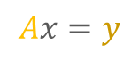
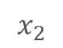
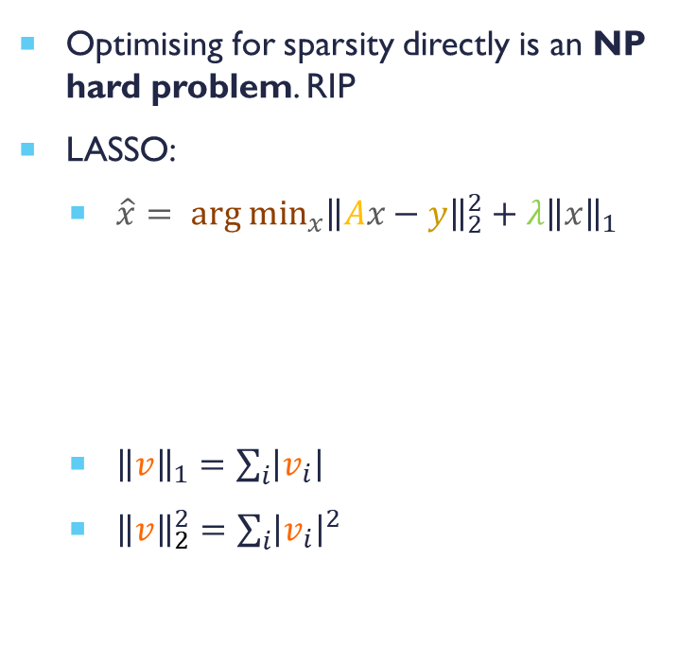
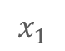

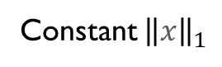
Optimisation
Optimising for sparsity directly is an NP hard problem. RIP
LASSO:
$\hat{x}= {arg min}_{x}{\left\|Ax−y\right\|}_{2}^{2}+λ{\left\|x\right\|}_{1}$
${\left\|v\right\|}_{1}=\sum_{i}{\left|v_{i}\right|}$
${\left\|v\right\|}_{2}^{2}=\sum_{i}{{\left|v_{i}\right|}^{2}}$
$$x_{2}$$
$$Ax=y$$
Smallest ${\left\|x\right\|}_{1}$ that fits $Ax=y$
Punishment for not fitting data
Punishment for not being sparse
$$x_{1}$$
Constant ${\left\|x\right\|}_{1}$

Slide 19

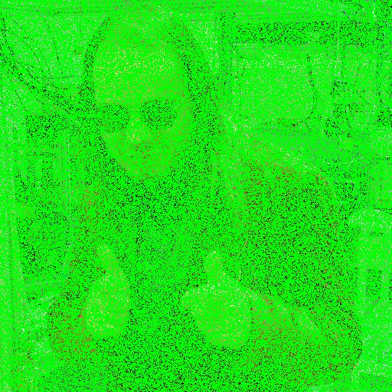
Solver and example
Iterative shrinkage-thresholding algorithm (ISTA)
Alternates gradient methods between 1- and 2-norms of the LASSO
Example
Only sample ~20% of pixels
100 iterations
Emulates “single pixel camera”
I’ll put code on github
Ground truth
Subsampled
(green is “unmeasured”)
Recovered

Slide 20
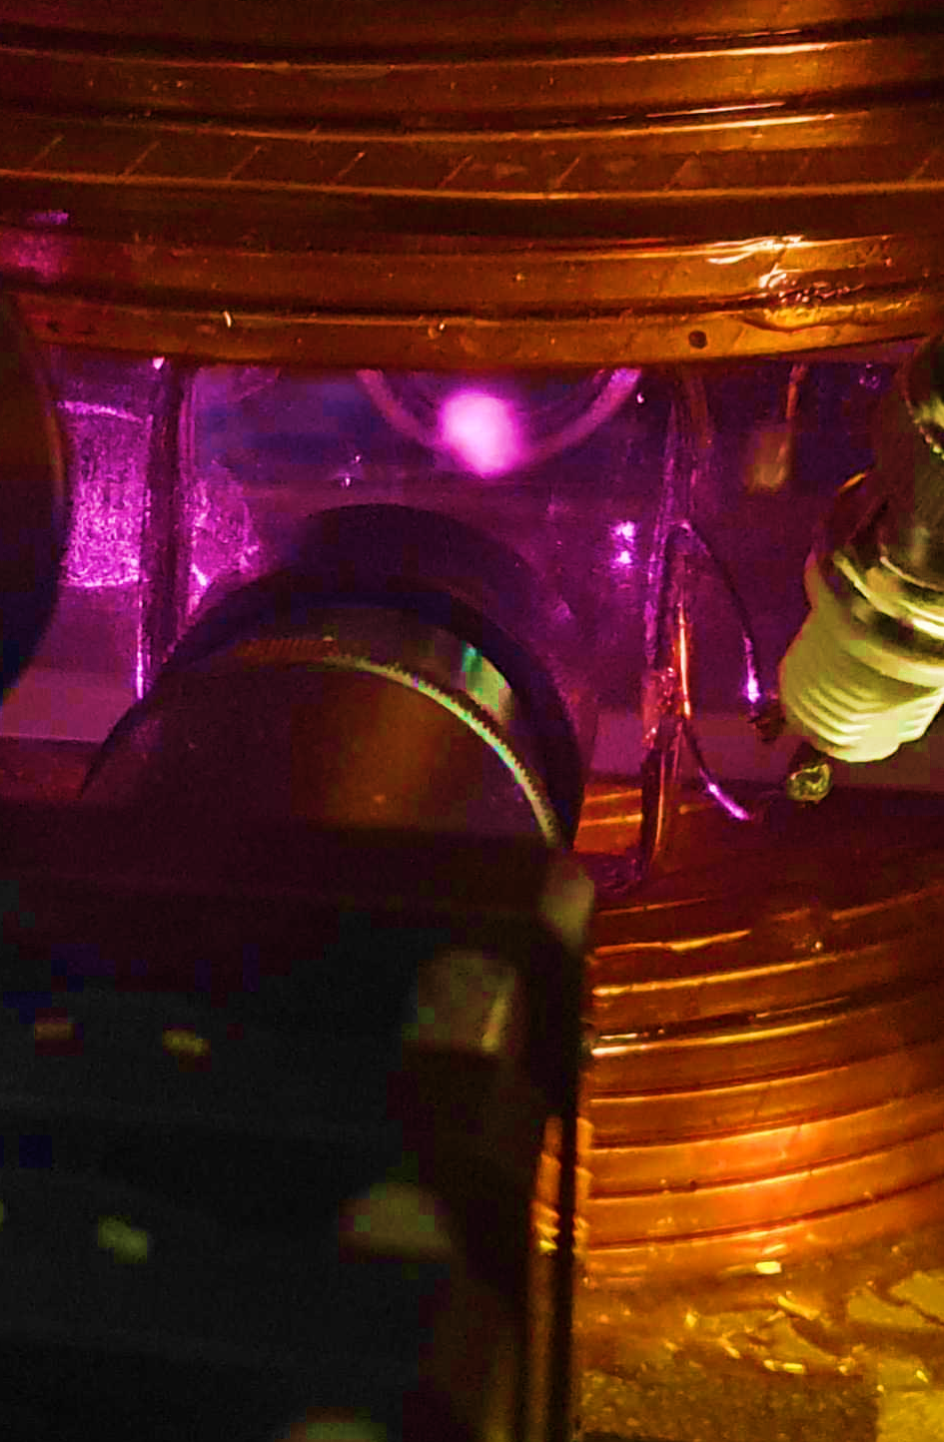
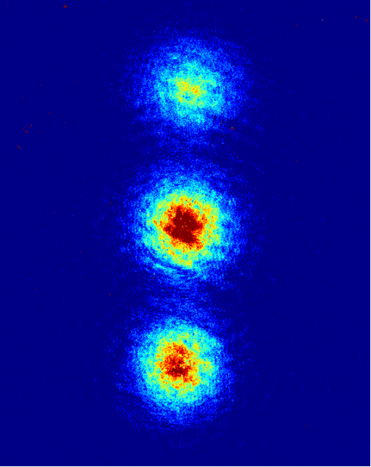
Relevant to my work
We make the coldest material in the universe (BEC)
It is sensitive to magnetic fields
We make magnetic field sensors out of it
It is “hard” to produce and control, so we want to get all we can out of our measurements
Credit: Chris Bounds
Credit: Hamish Taylor

Slide 21

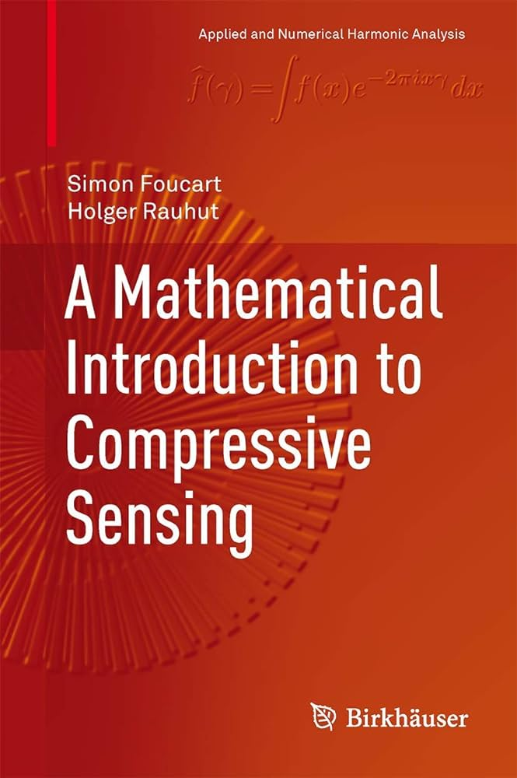
Recommended reading
General overview: Koep et. al. Compressed sensing and its applications Chapter1: An Introduction to Compressed Sensing
Comprehensive deep mathematical rabbit hole: Foucart and Rauhut A Mathematical Introduction to Compressive Sensing

